Slide 1
WorkSafe Victoria – Scheme Update
The past and the future
(and our roadmap to get there)
Lynda Young
© WorkSafe Victoria
This presentation has been prepared for the Actuaries Institute 2013 Injury Schemes Seminar.
The Institute Council wishes it to be understood that opinions put forward herein are not necessarily those of the Institute and the Council is not responsible for those opinions.

Slide 2
Overview
The past - history & context
The future (and our roadmap to get there) - Strategy 2017
Detailed trends, targets
  Sustainability
  Safety
  Service
  Return to work
Challenges

Slide 3
History and context
2000 - 2013
Cycle of cost blow outs – premium increases – legislative change – periods of stability
Strong financial results - improved service and safety – focus on RTW – benefit improvements
1985 - 2000
Last 5 years the rate of improvement is slowing and in some areas has plateaued
Our challenge for the next 5 years is how to achieve further step change in key areas to improve the balance in our scheme

Slide 4
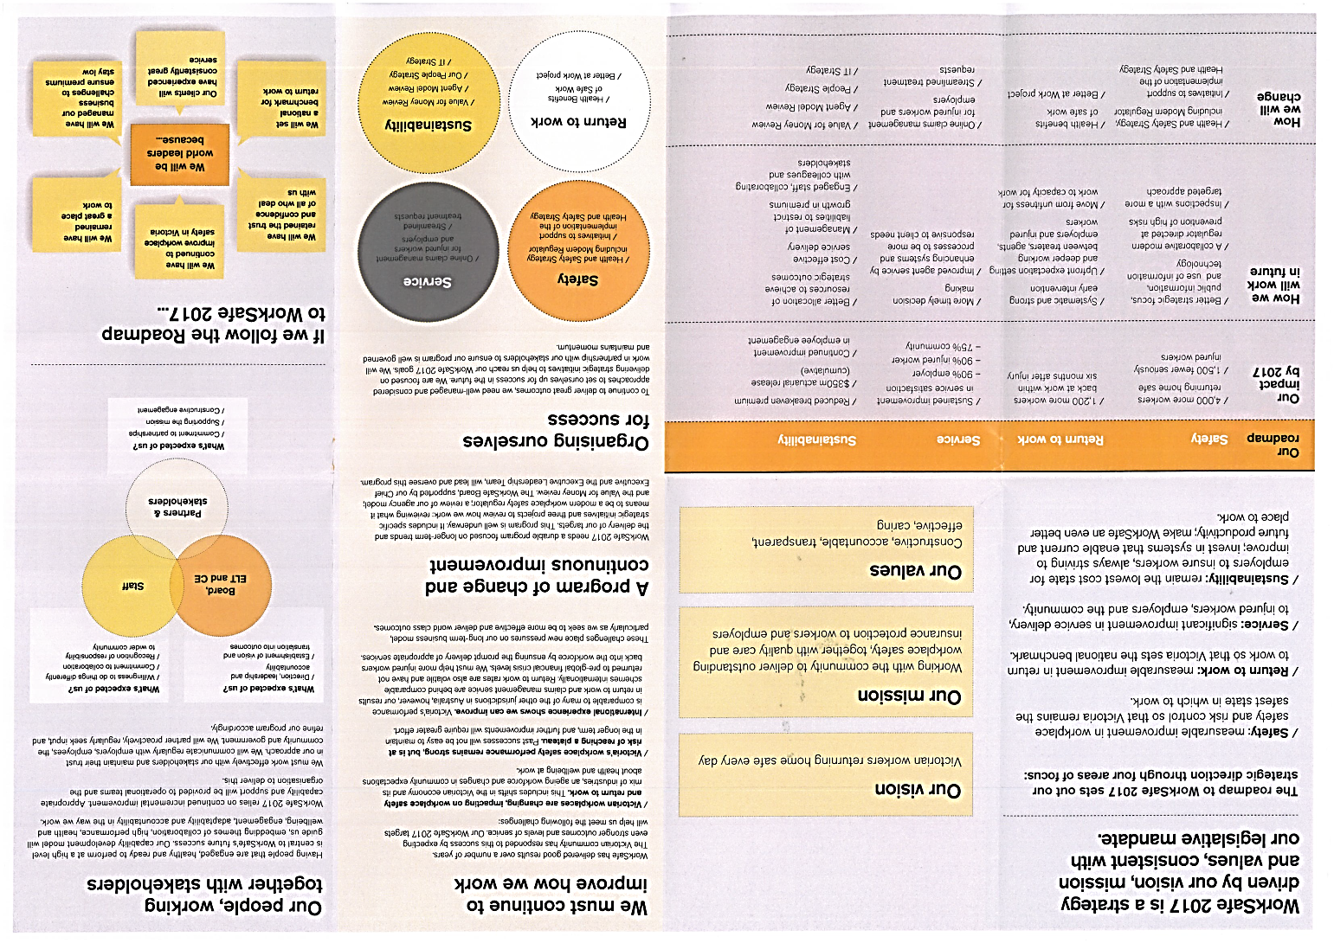
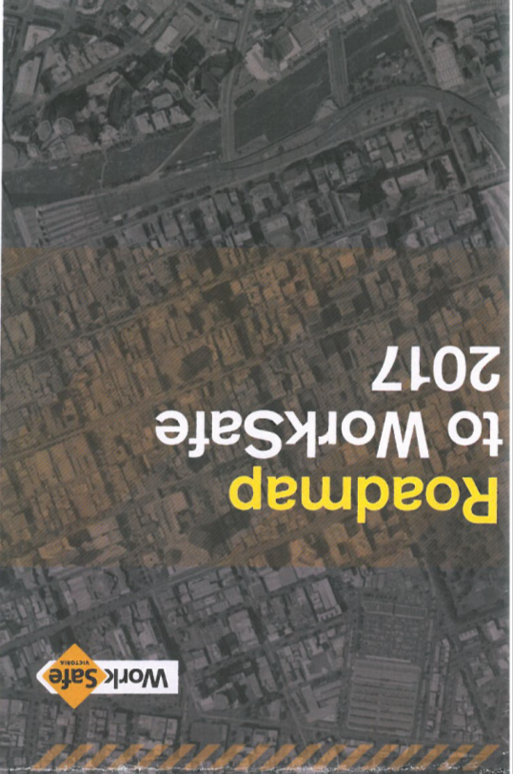
The next 5 years – Strategy 2017

Slide 5
2017 Key KPI’s

Slide 6
A well-managed program of change focused on the future
Safety
- Health & Safety Strategy
- Initiatives arising from the Health & Safety Strategy
Return to work
- Health Benefits of Safe Work
- Better at Work project
Service
- Online claims management - employers and injured workers
- Streamlined treatment requests
Sustainability
- Value for Money Review
- Agent Model Review
- Our People and IT Strategies

Slide 7
Sustainability trends & targets
Year | Average | Funding | Net | PFIO | Actuarial | Dividend
 | premium | ratio % | profit/loss |  | release | Paid
1999/00 | 1.900% | 86%# | ($127M) | ($460M) | ($564m)
2000/01 | 2.220% | 88% | ($260M) | ($262M) | ($366m)
2001/02 | 2.220% | 87% | ($98M) | $465M | $121M
2002/03 | 2.220% | 83% | ($315M) | $505M | $157M
2003/04 | 2.220% | 101% | $1.22B | $718M | $316M
2004/05 | 1.998% | 113% | $775M | $747M | $439M
2005/06 | 1.800% | 119% | $1.003B | $476M | $260M
2006/07 | 1.620% | 134% | $1.17B | $729M | $349M
2007/08 | 1.460% | 120% | ($587M) | $985M | $511M
2008/09 | 1.387% | 97% | ($1.255B) | $277M | $78M
2009/10 | 1.387% | 100% | $176M | $654M | $189M
2010/11 | 1.338% | 108% | $521M | $294M | $136M
2011/12 | 1.338% | 96% | ($676M) | $385M | $182M | $147m
2012/13 | 1.298% | 108% | $1.084B | $119M | $179M | $193m
Strong results over last 10 or so years
Relatively modest future targets
2017 1.200% 85%-115% $350M
(cumulative)

Slide 8
Safety – total claims per million hours worked

Slide 9
Safety - 4-week claims

Slide 10
RTW - Not yet at work

Slide 11
Service

Slide 12
Challenges
Financial Sustainability
Common Law
Price pressures in medical and like costs
Service
Increased community expectations about health and well-being at work
Safety & RTW
Changing mix of industries
Ageing workforce
- Economic conditions

Slide 13
